Slide 1
Group Project 2
CS 331
Nov. 5. 2019 - Nov. 17. 2019
Group Members
Thomas Jimenez
Mudit Prashar
Dylan Rambarran

Slide 2
Team Contributions
Thomas Jimenez – Project Manager
Mudit Prashar – Tracking documents, Project Planner
Dylan Rambarran – Powerpoint, Video

Slide 3
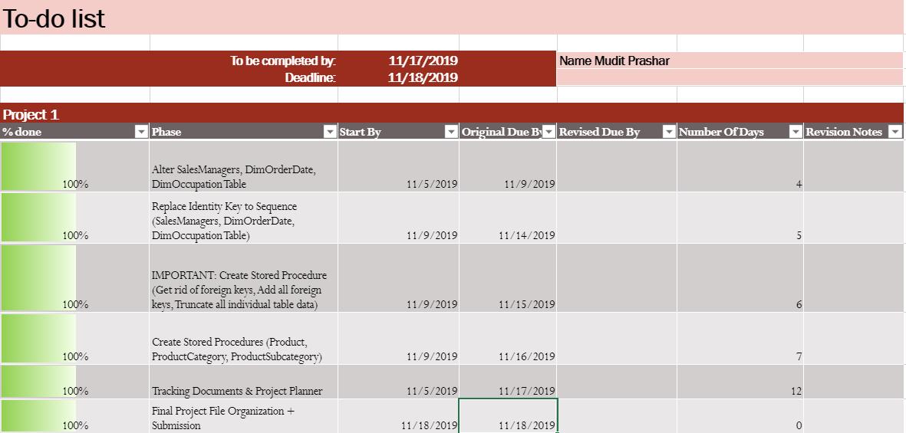
Todo List Documentation
The phases were divided by the following:
Altering tables
Creating Sequence Objects
Creating Stored Procedures
Combining our procedures and deciding on the design for the project
Creating our group presentation based on our powerpoint and jdbc execution
Final file organization for submission
The todo list for group members only changed if:
A particular member had an additional responsibility (i.e. creating a java application for jdbc execution, slides on the powerpoint that were not based on individual efforts)

Slide 4
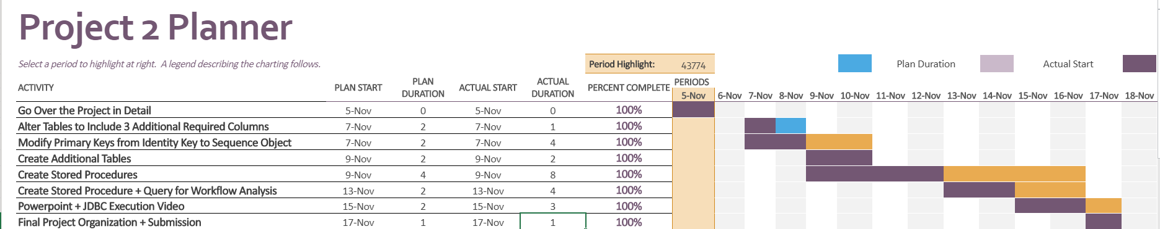
Project Plan Documentation
Project Planner was set after the first meeting.
Each activity serves as task all the member in the team has to do or contribute to.
Project planner helped laying out the structure for the project and break it down in parts.
Plan Date and Plan duration was set in advance.

Slide 5
Notable Team Effort
Thomas: Responsible for the JDBC, Overseeing project, Sequence objects, Creating procedures
Mudit: Responsible for the Project Planner, Tracking documentation, Altering tables, Creating Procedures
Dylan: Powerpoint, Assembling videos, Creating procedures

Slide 6
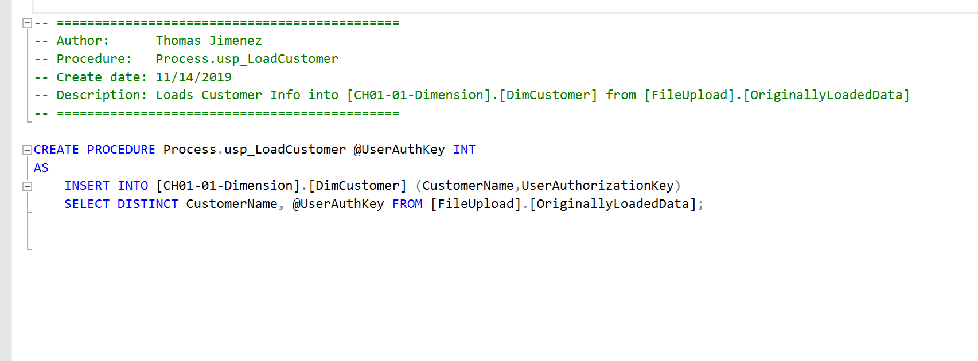
Thomas' Procedures
LoadCustomer

Slide 7
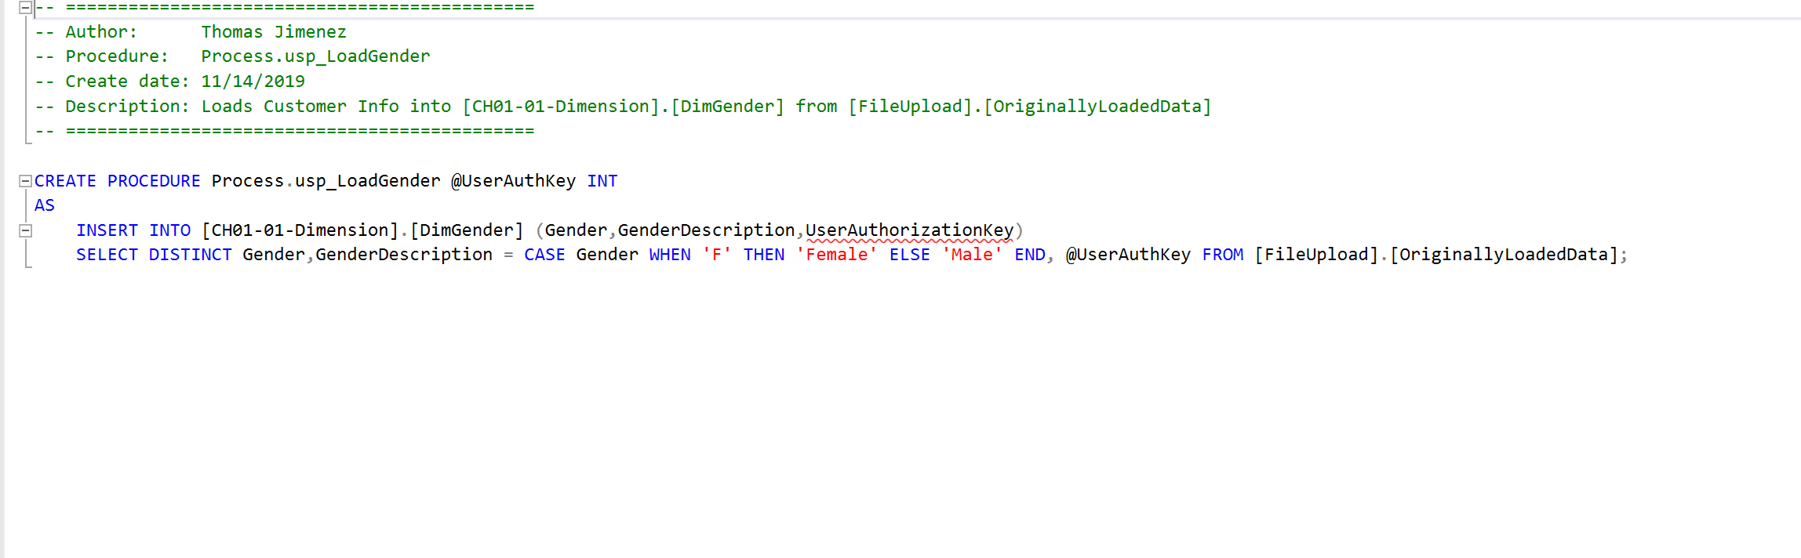
Thomas' Procedures
LoadGender

Slide 8
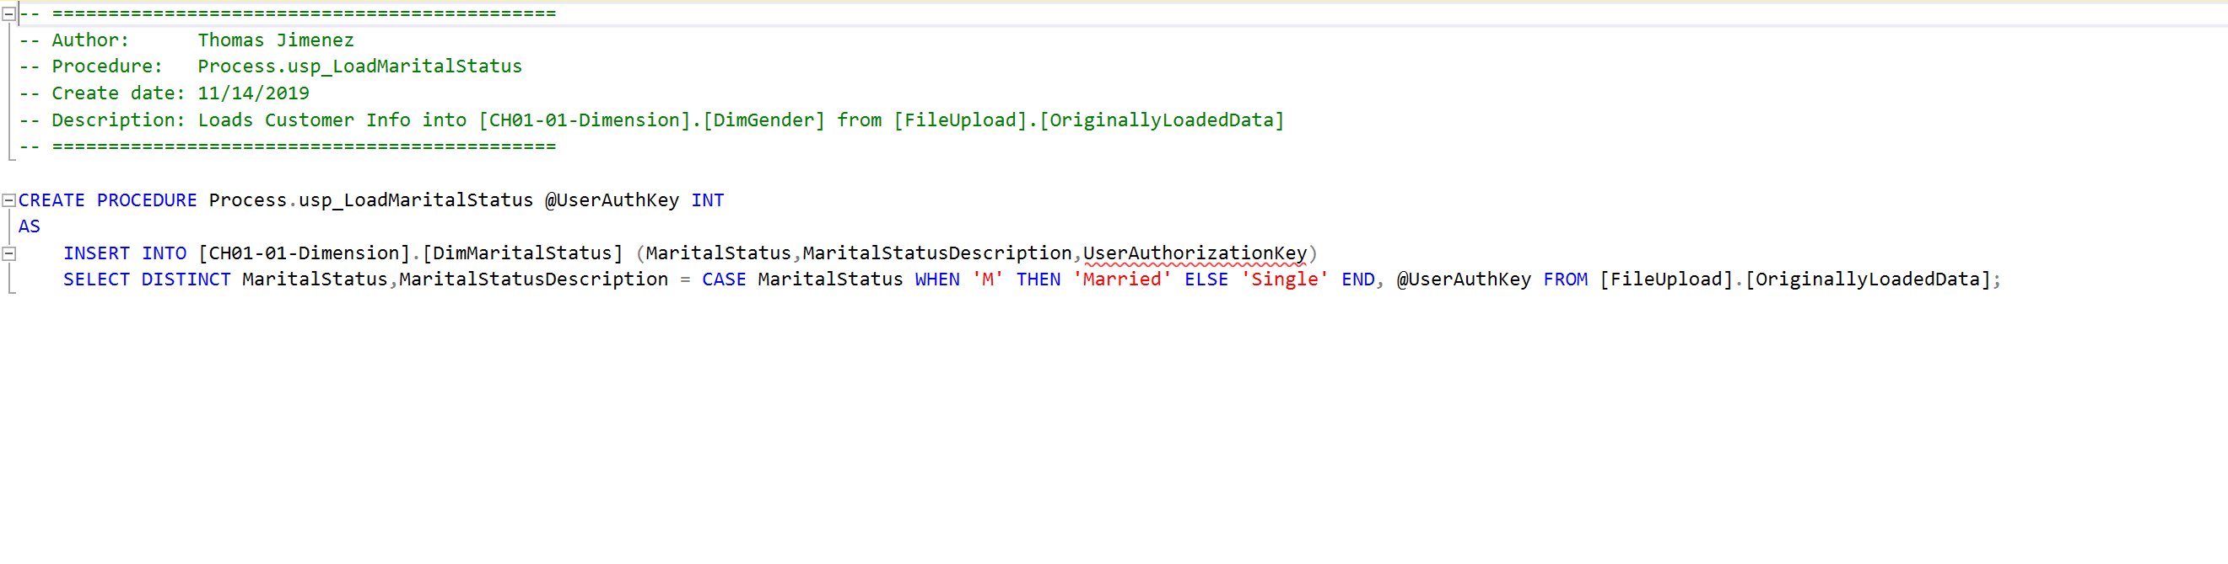
Thomas' Procedures
LoadMaritalStatus

Slide 9
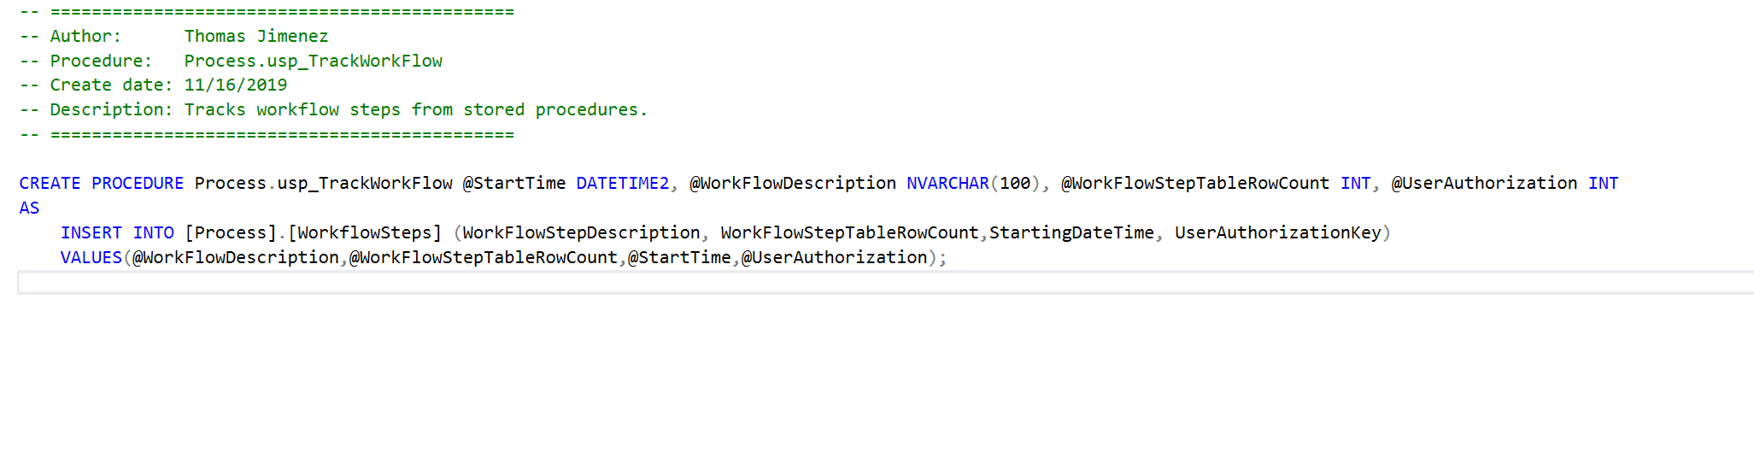
Thomas' Procedures
TrackWorkFlow

Slide 10
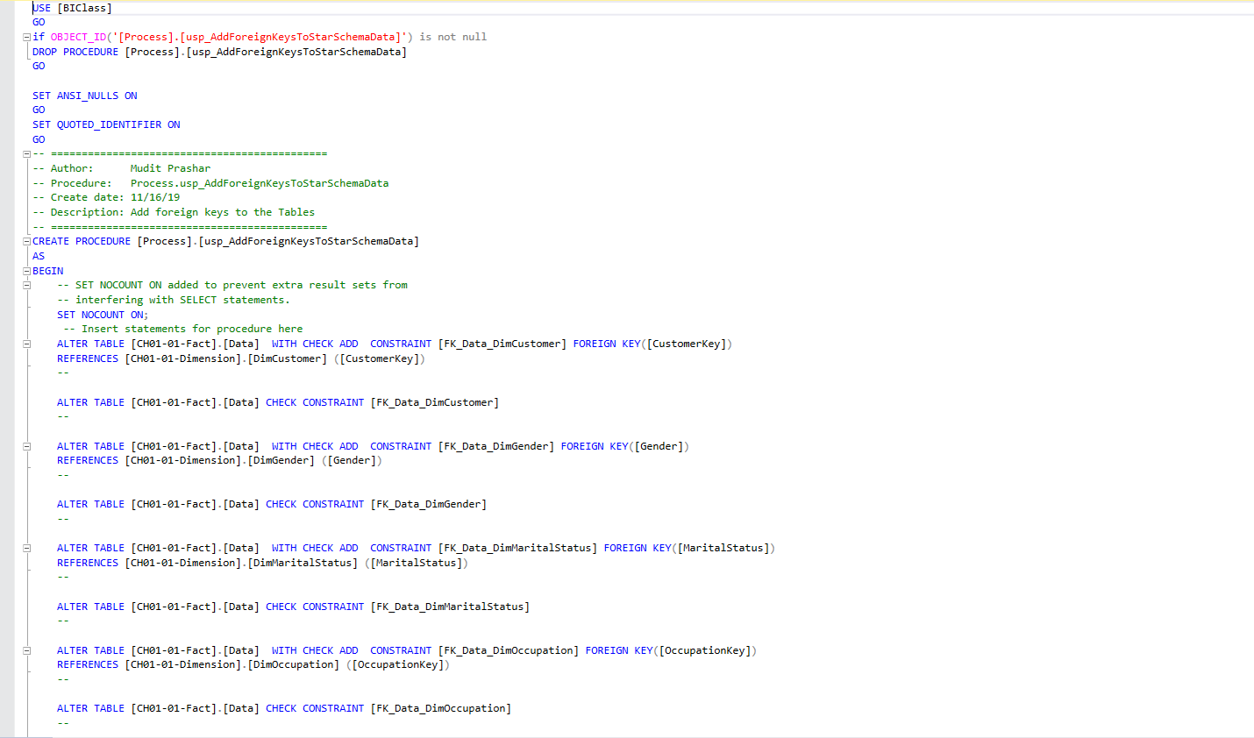
Mudit's Procedures
AddForeignKeysToStarSchemaData

Slide 11
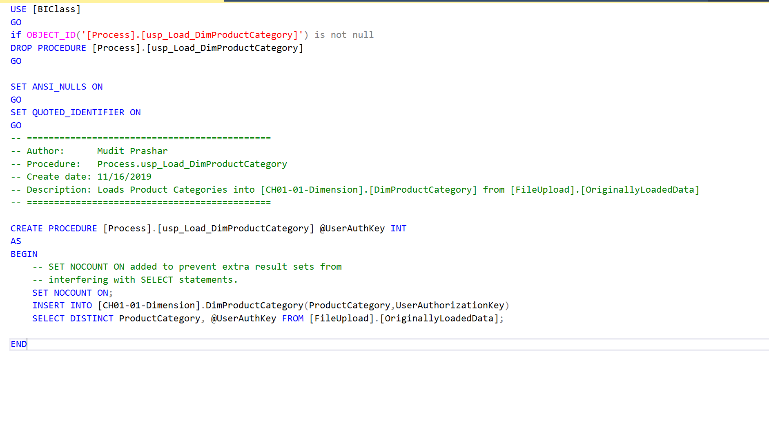
Mudit's Procedures
LoadCategory

Slide 12
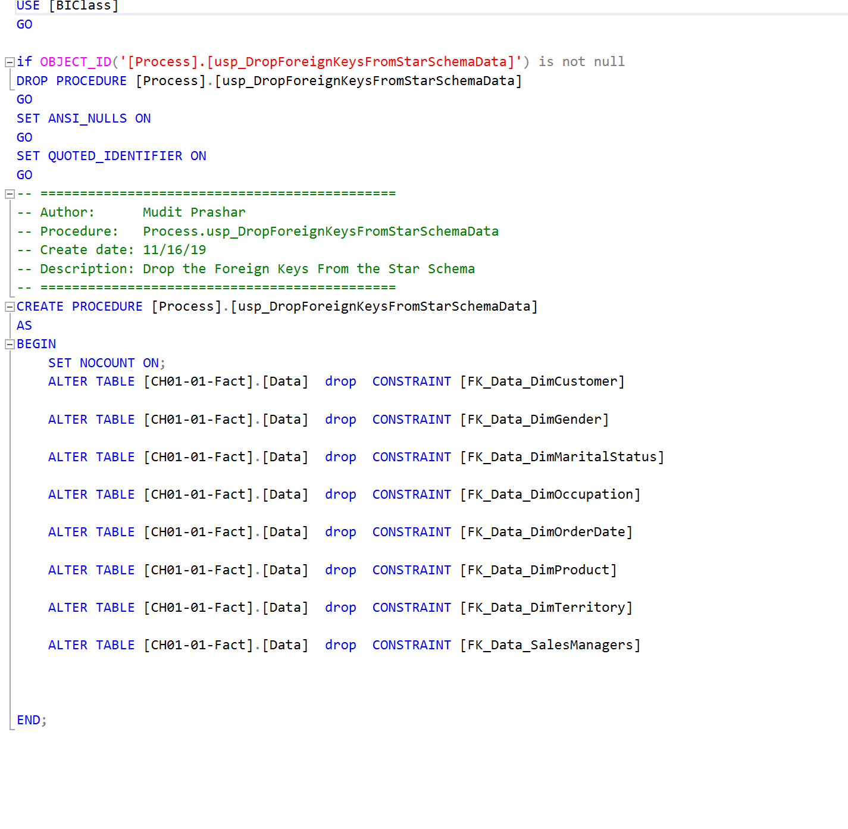
Mudit's Procedures
DropForeignKey

Slide 13
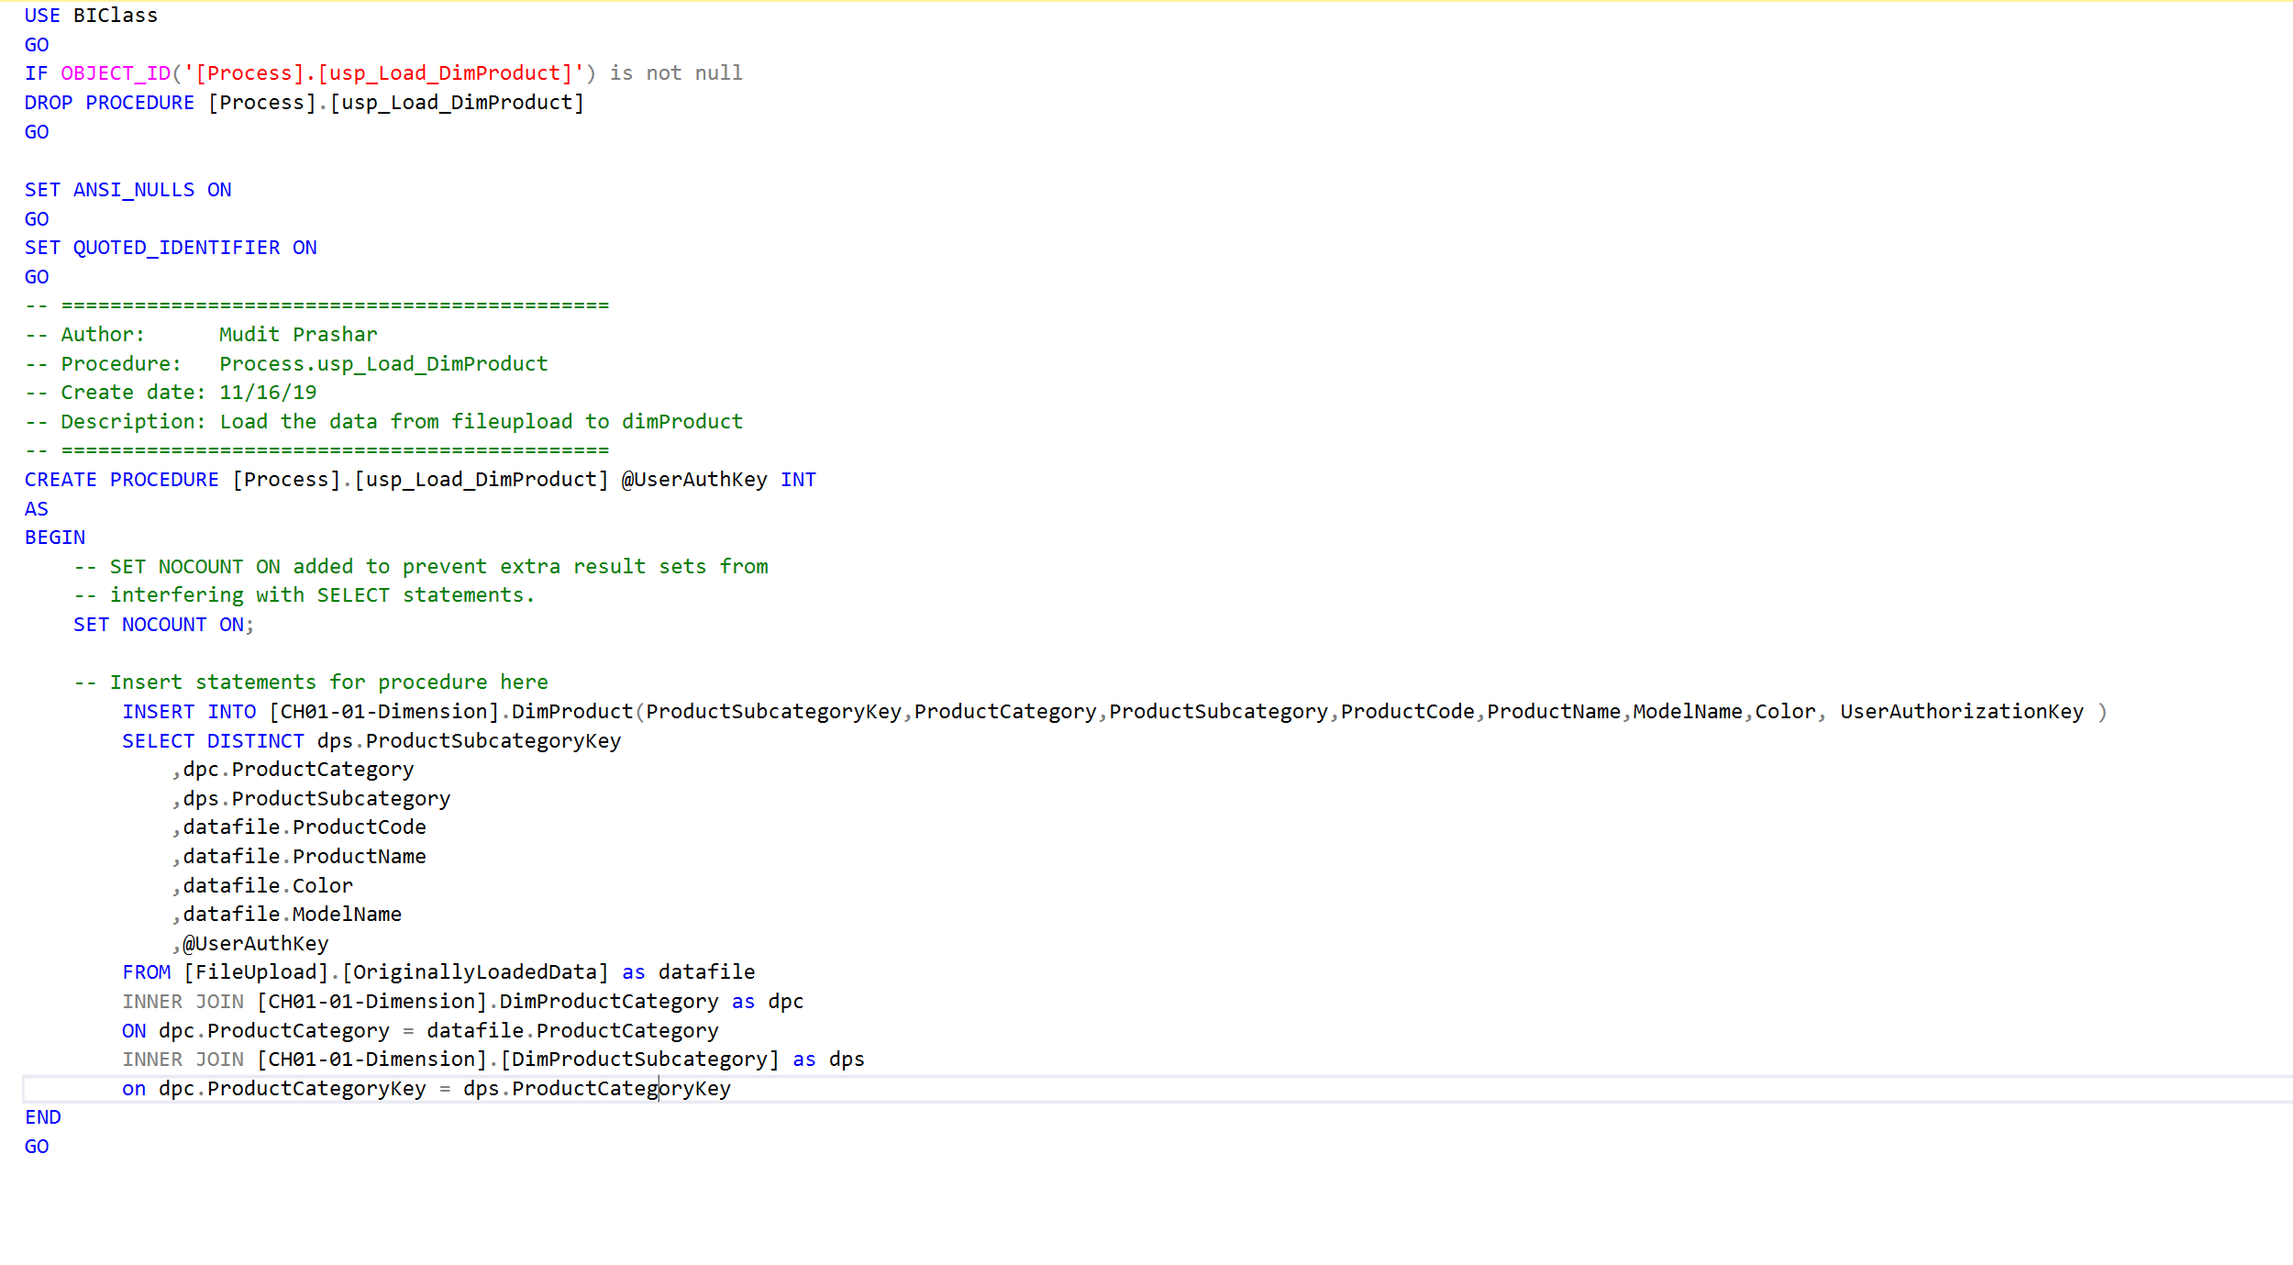
Mudit's Procedures
LoadProduct

Slide 14
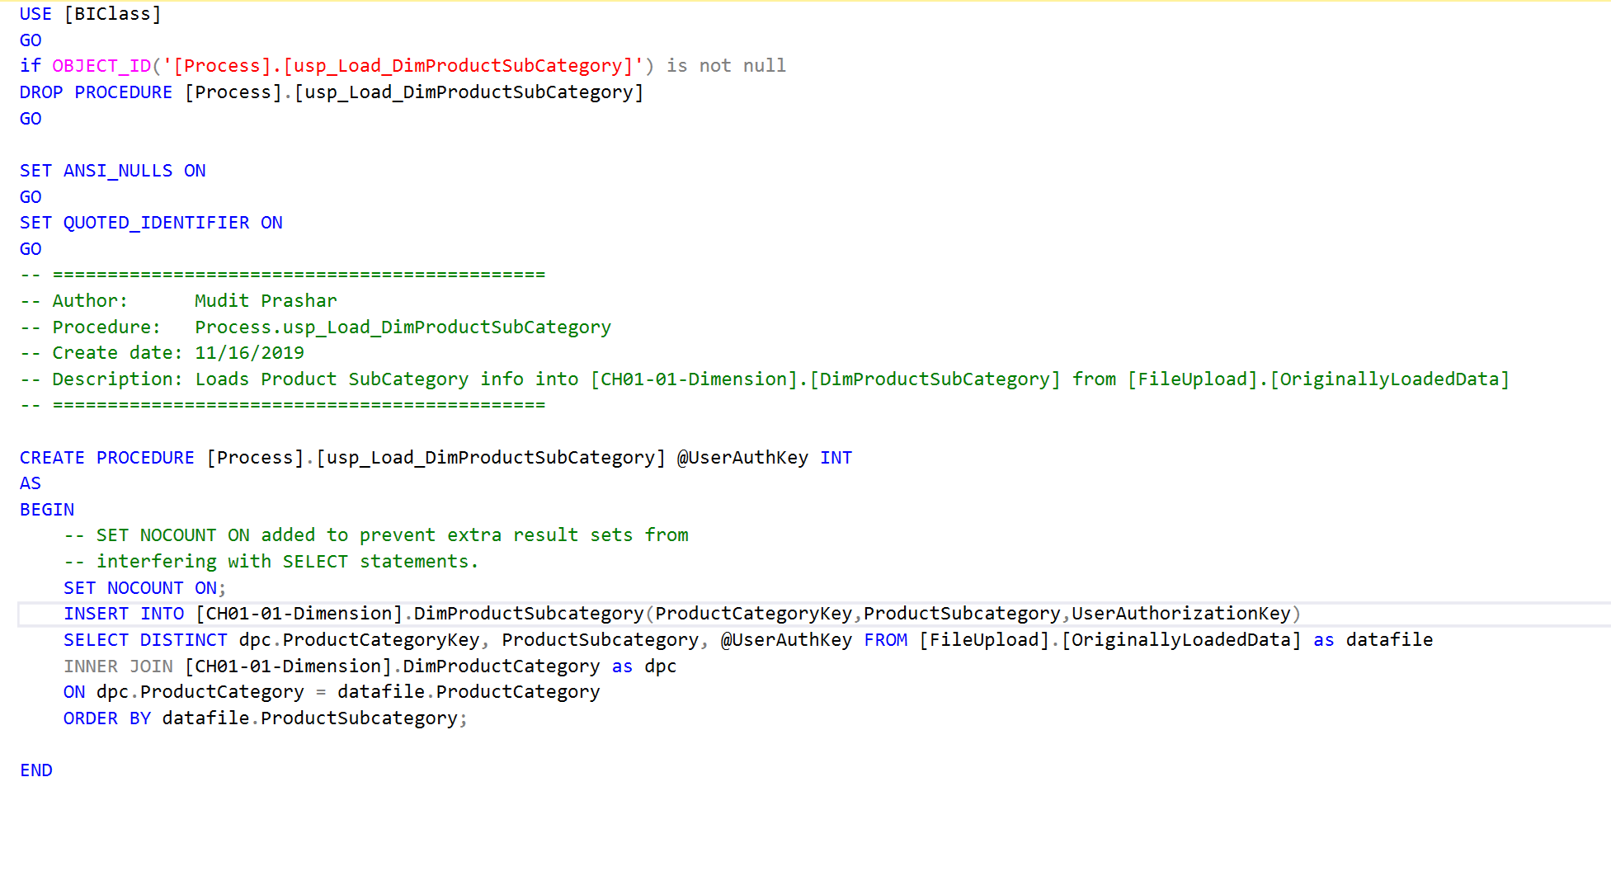
Mudit's Procedures
LoadProductSubcategory

Slide 15
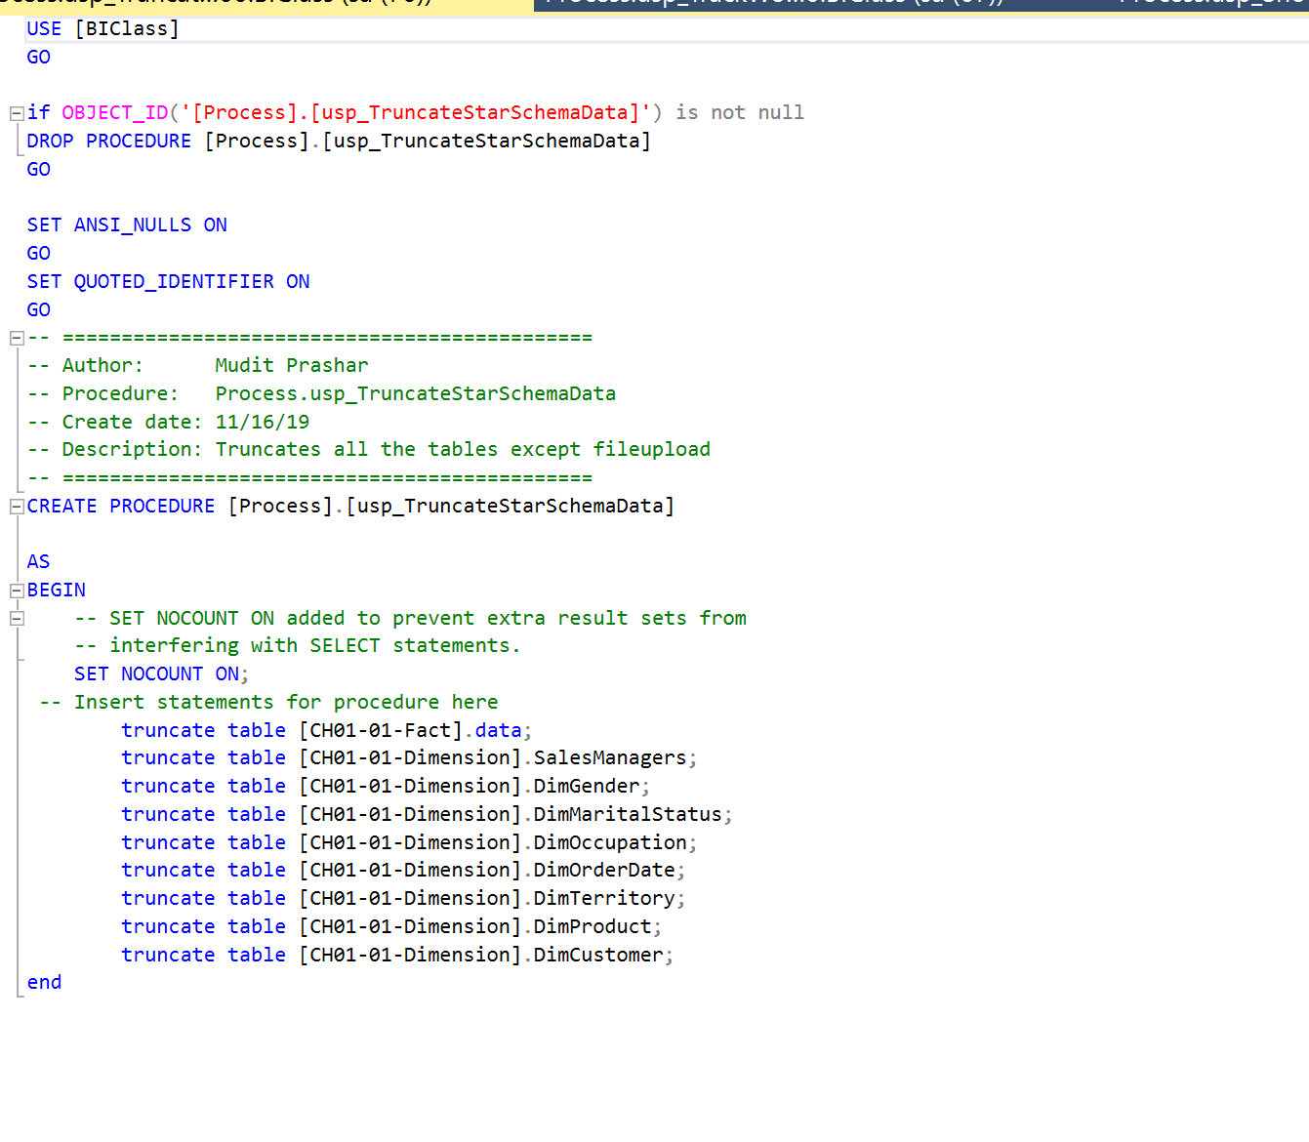
Mudit's Procedures
TruncateStarSchemaData

Slide 16
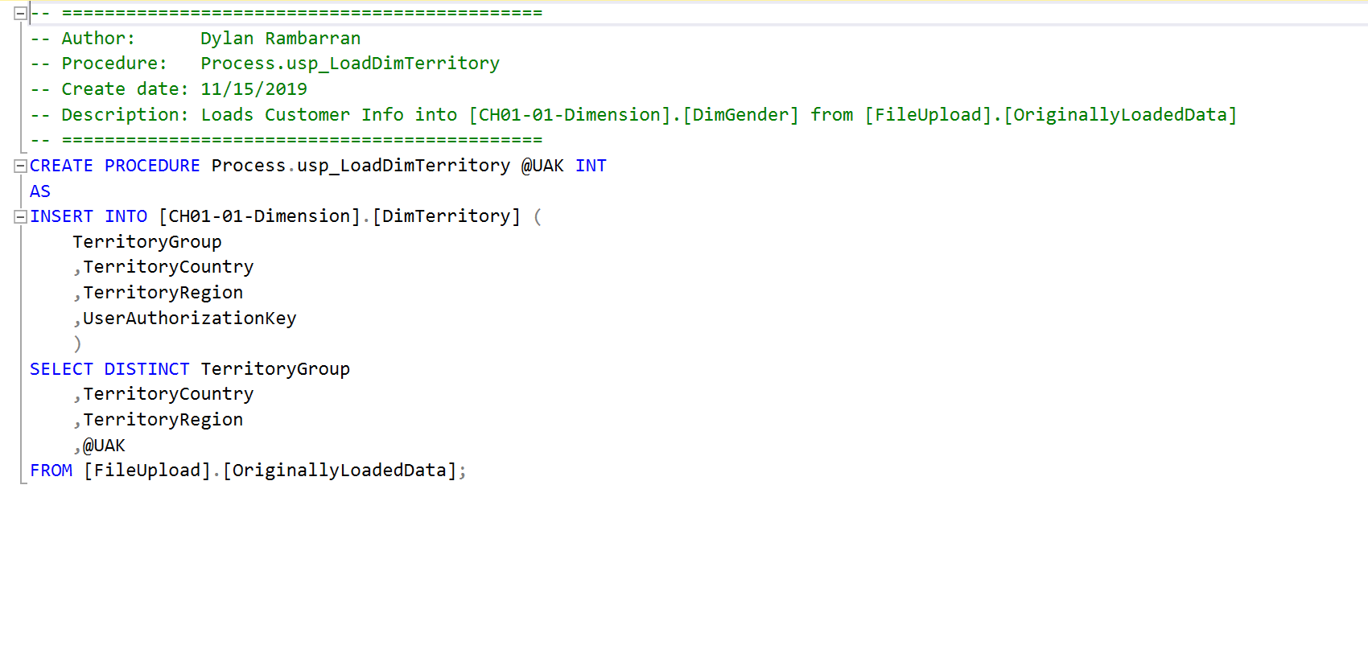
Dylan's Procedures
LoadTerritory

Slide 17
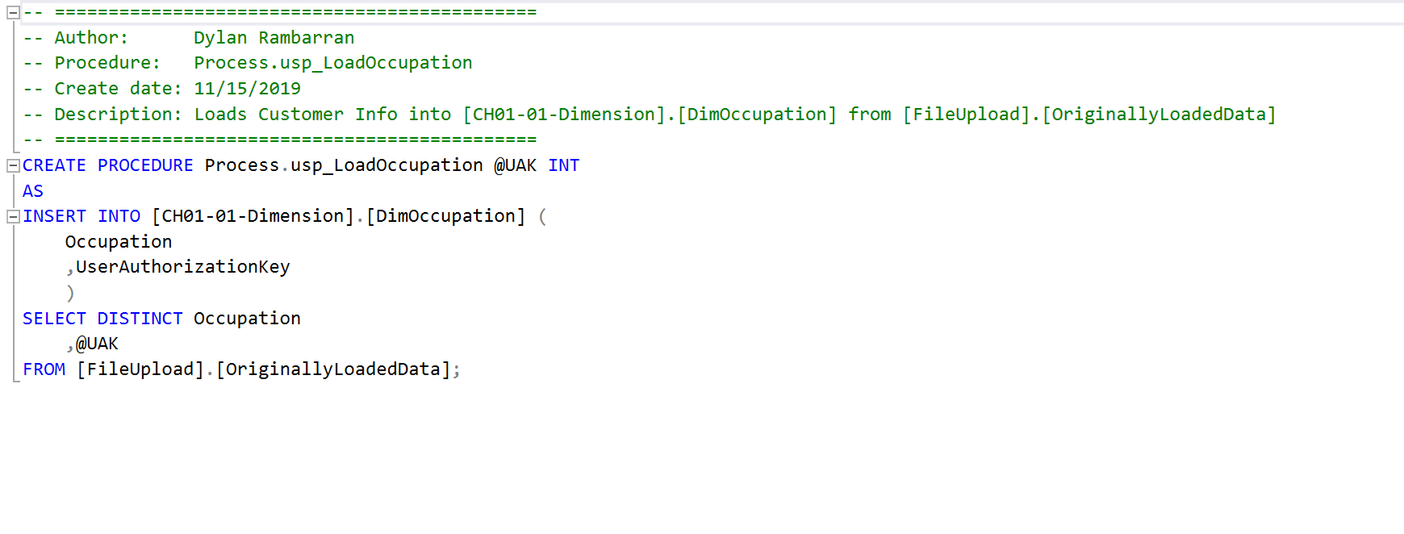
Dylan's Procedures
LoadOccupation

Slide 18
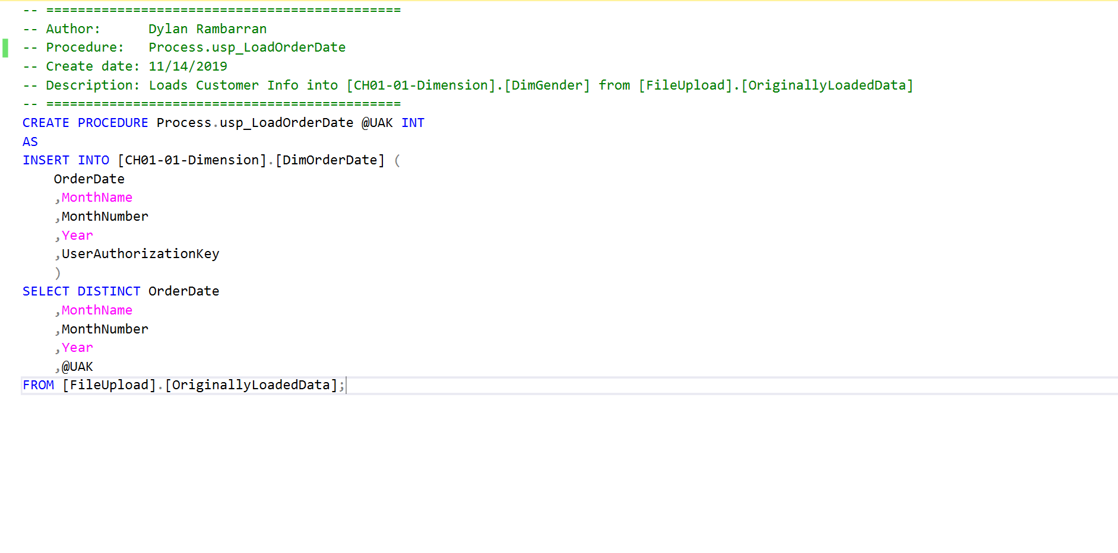
Dylan's Procedures
LoadOrderDate

Slide 19
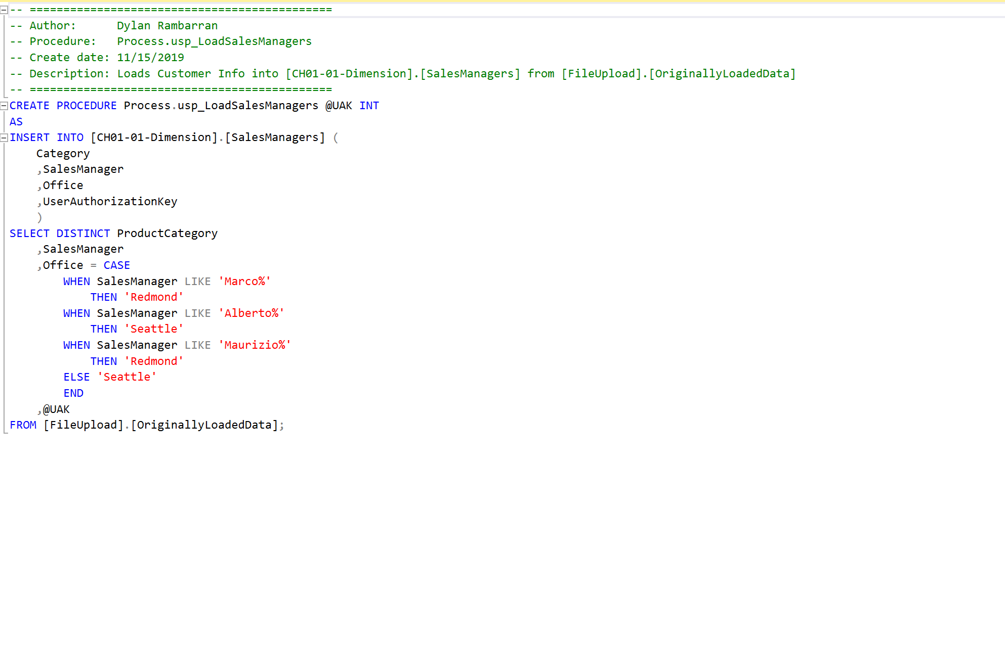
Dylan's Procedures
LoadSalesManagers

Slide 20
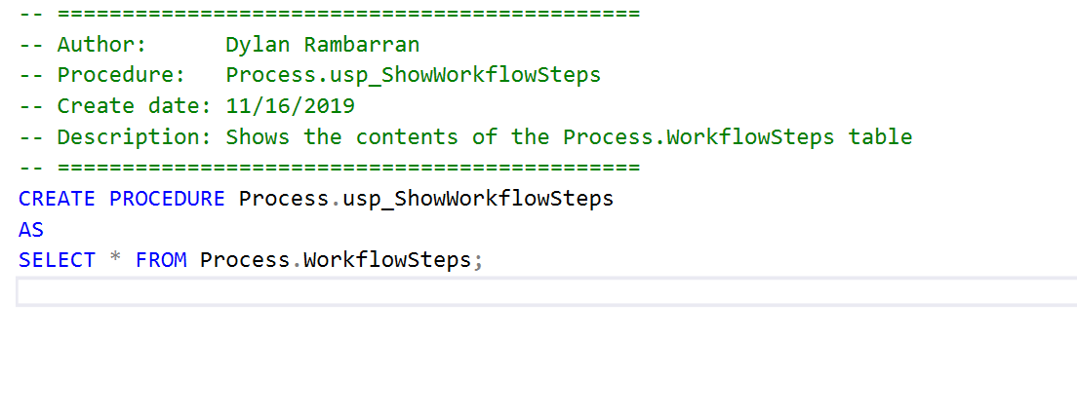
Dylan's Procedures
ShowWorkflowSteps

Slide 21
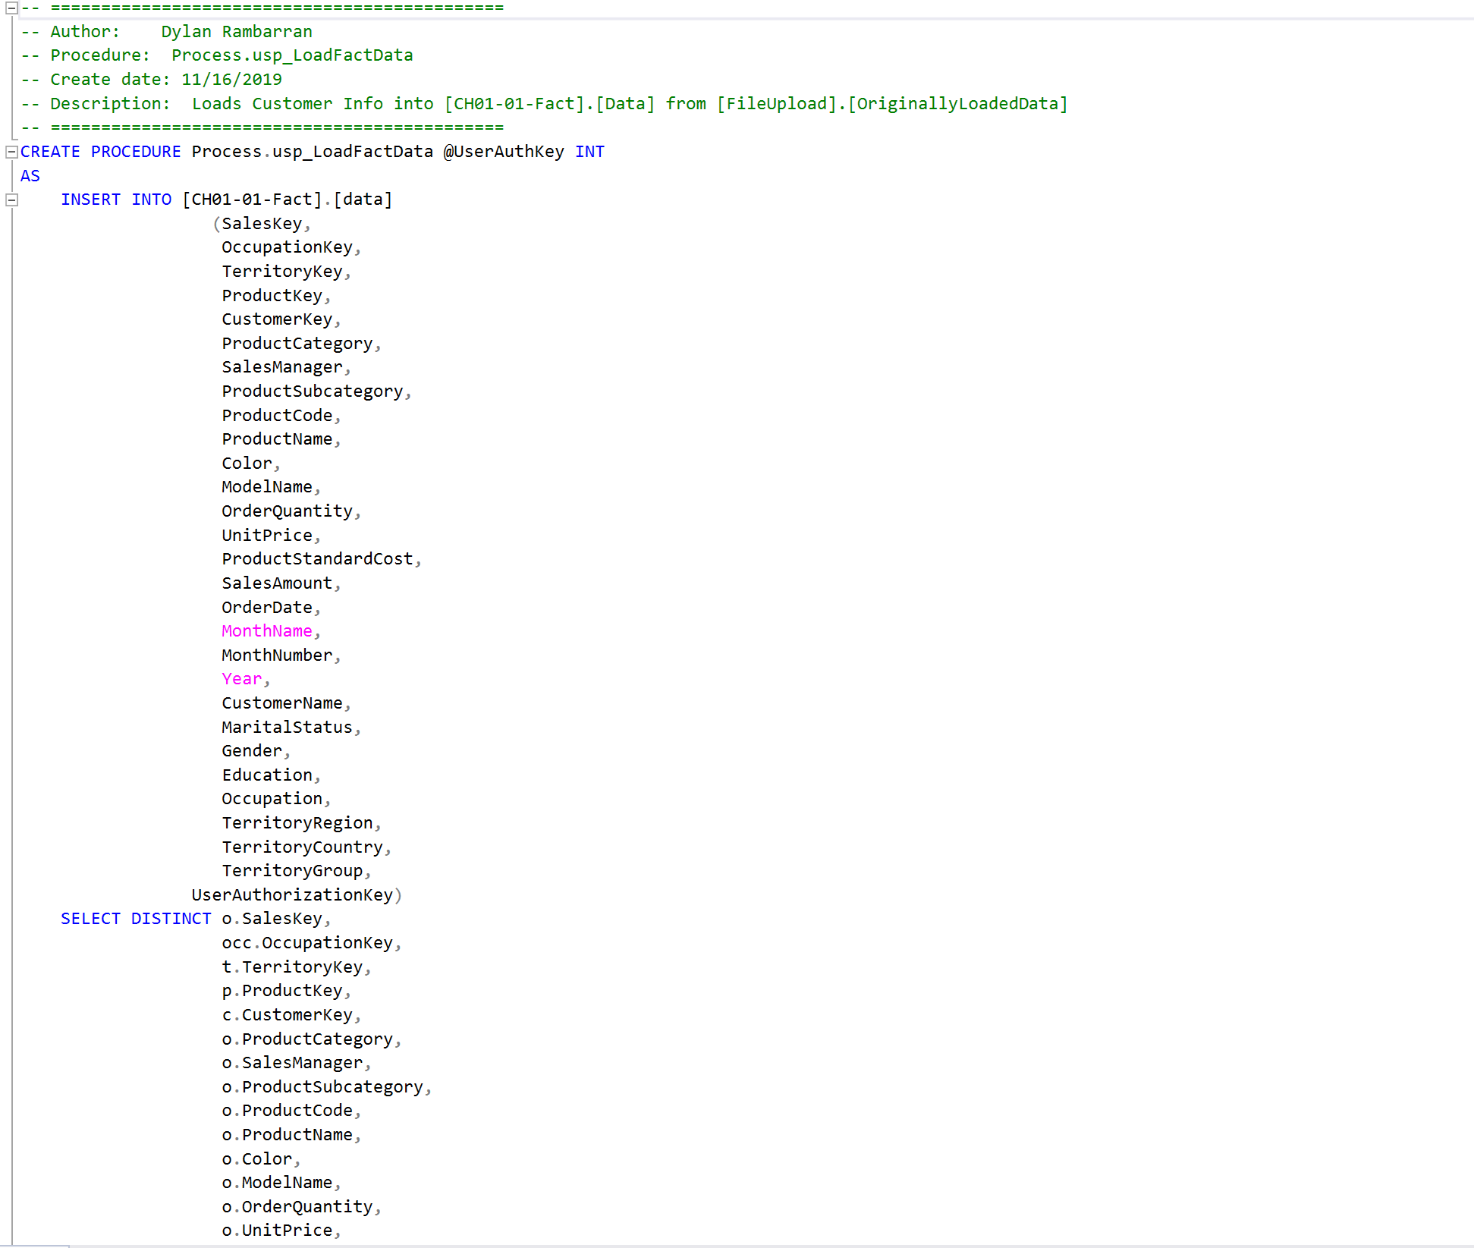
Dylan's Procedures
LoadFactData

Slide 22
Thank you

